Slide 1
Kansas Medicaid Enrollment Analytics
CMS Medicaid/CHIP Data + BLS Unemployment API

Slide 2
Questions I had in my mind
How did Kansas Medicaid/CHIP enrollment change from 2017–2026?
Did unemployment explain the enrollment trend?
What periods should leadership pay attention to?

Slide 3
Data Sources & Workflow
  Sources
  CMS Medicaid/CHIP enrolment CSV
  BLS Public Data API for Kansas unemployment
  Basic workflow
  Raw data → cleaning → validation → join by month → analysis → charts

Slide 4
Data Challenges & Decisions
CMS had both preliminary and updated records.
I selected final/updated records where available.
2013 was an isolated historical record, so I used continuous monthly data from 2017 onward.
BLS API had one missing unemployment value for Oct 2025, so I interpolated it and flagged it

Slide 5
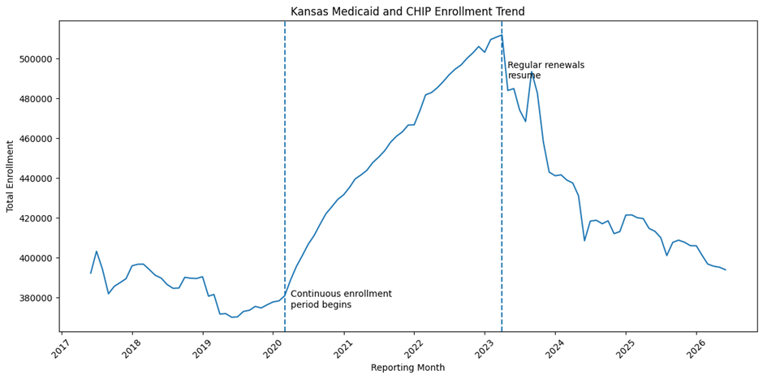
Enrollment Trend
Lowest enrollment: 370,030 in June 2019
Peak enrollment: 512,005 in April 2023
Increase from low to peak: +38.37%
Decline from peak to June 2026: -23.06%

Slide 6
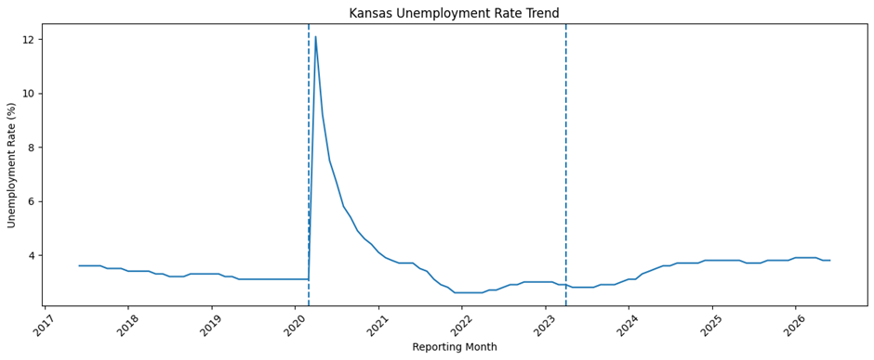
Unemployment Comparison
Unemployment spiked around 2020 but declined quickly.
Medicaid enrollment kept rising until 2023.
Correlation was weak: -0.28
So unemployment alone does not explain the enrollment pattern.

Slide 7
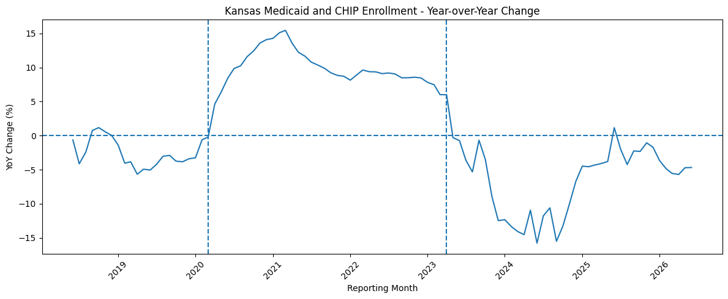
Final Takeaways
Enrollment growth aligned more closely with the continuous-enrollment period than with unemployment alone.
After regular renewals resumed, enrollment declined sharply.
This kind of analysis can help leadership monitor enrollment shifts, policy impacts, and periods
needing deeper review.

